Slide 1

EXploratory data analysis using facebook dataset
BY: CARLTON DSOUZA

Slide 2
FEW facts ABOUT FACEBOOK
Facebook was launched on February 4, 2004 , by Mark Zuckerberg and his Harvard College roommates.
Initially called Facemash
2.6 billion customers as of Jul 2020
Third most popular site after Google and Youtube
More than 350 million photos are uploaded daily on Facebook
India has the largest number of Facebook users (260 million)

Slide 3
Table of contents
The different stages of Exploratory Data Analysis
Problem Statement and Data Description
Data profiling and pre-profiling
Exploratory Data Analysis
Conclusion and Insights from EDA

Slide 4
Stages of exploratory data analysis
1. Define Problem
2. Choose right tools
3. Collection of data
4. Pre-profile
5. Pre-Processing of data (clean, remove unnecessary data, add relevant data)
6. Post-profile
7. Ask right questions
8. Conclusion or summarization
9. Actionable insights

Slide 5
PROBLEM STATEMENT
Analyzing human behavior when using Facebook
01
Understanding patterns of Facebook usage across the age groups and gender
02

Slide 6
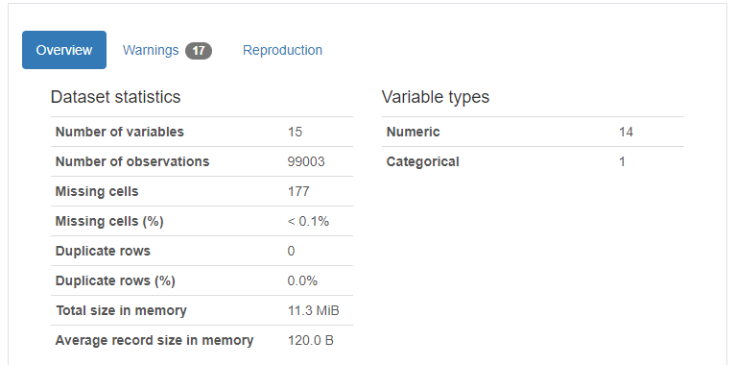
ABOUT THE FACEBOOK DATASET

Slide 7
PRE-PROFILING OF THE FACEBOOK
No columns have been dropped from the dataset and all columns have been retained for this EDA
We will continue to perform the exploratory data analysis using all the available data

Slide 8
Exploratory data analysis using charts
We will use a number of charts to understand and analyze this dataset which are noted below:
Pie Chart
Bar Chart
Pivot Tables
Heat maps
Violin Chart

Slide 9
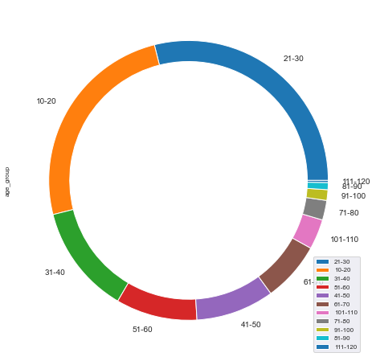
Using a pie chart to understand the number of users across age groups
Users in the age group of 21 to 30 have the highest number of users.
The number of users across keeps decreasing as the age goes on increasing

Slide 10
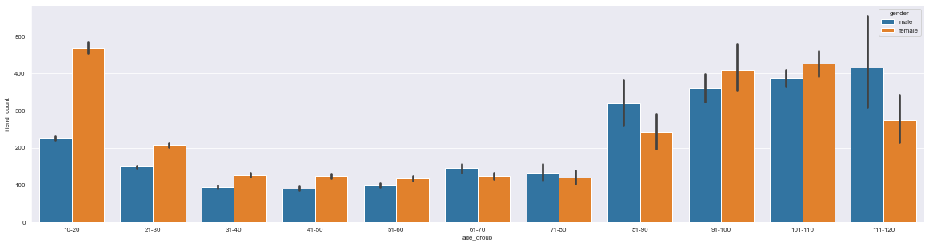
Gender-wise usage across age groups
As can be seen in the bar plot above, we are tracking here the usage of Facebook across age groups and gender
Female users are higher in the adolescent, teens and early adulthood while male users are higher in the elderly age group

Slide 11
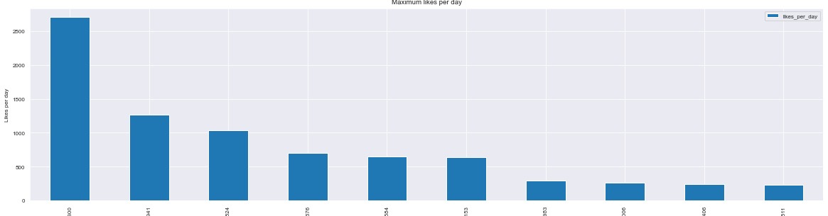
TRACKING USERS WITH MAXIMUM LIKES IN A DAY
In this slide, we are tracking the users who have received the maximum number of likes in a day. As can been seen below, one user has received more than 2500 likes in a single day for a post/update on Facebook

Slide 12
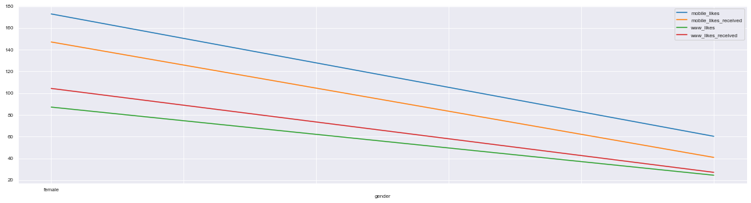
Likes received on app vs website
Here we are looking through a pivot table chart the number of likes received across age groups and gender while using mobile app versus website. Clearly the usage is higher on the mobile application

Slide 13
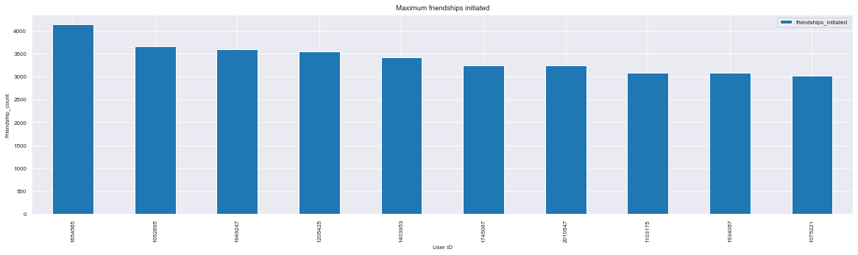
FRIENDSHIPS INITIATED
Next in the below bar chart, we are tracking the user with the highest amount of friendships initiated. As can be seen below, one particular user has initiated more than 4000 friendship requests

Slide 14
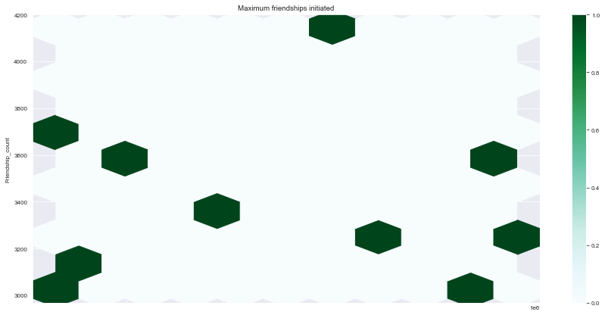
FRIENDSHIPS INITIATED THROUGH HEX PLOT
To make the plot more visual and easy on the eye, using a hex plot to track the correlation of the friendships initiated across the user group

Slide 15
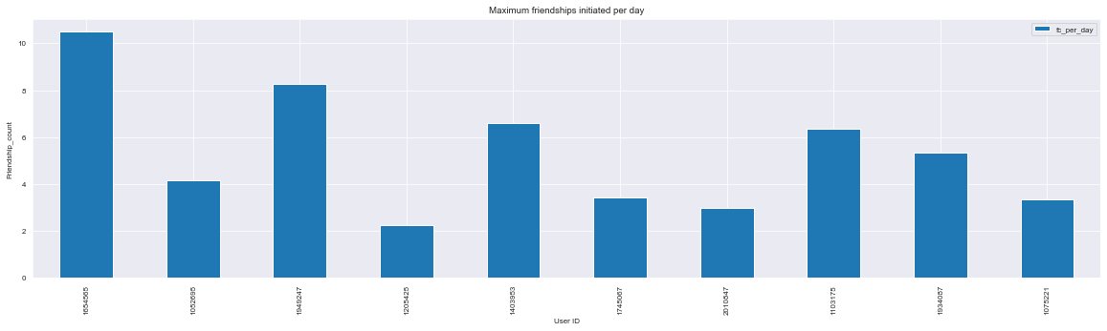
FRIENDSHIPS INITIATED PER DAY
In this slide, we are looking at the number of friendships initiated per day wherein one particular user has initiated more than 10 friendship requests in a single day

Slide 16
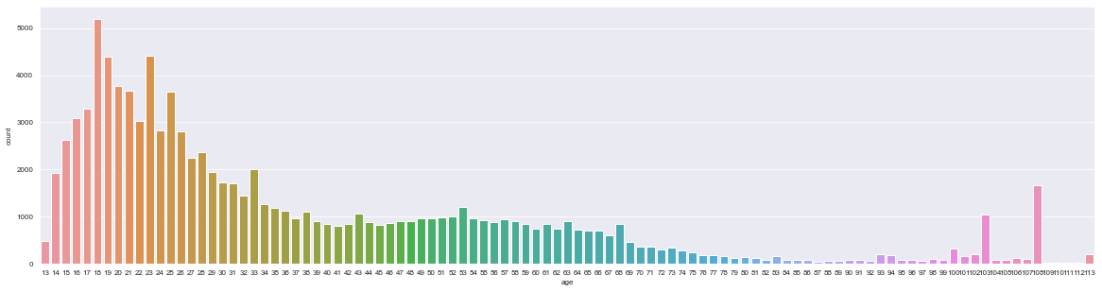
NUMBER OF USERS ACROSS GROUPS
This is a simple slide highlighting the number of users in the early groups is certainly higher than the elderly age groups expect for a couple of outliers

Slide 17
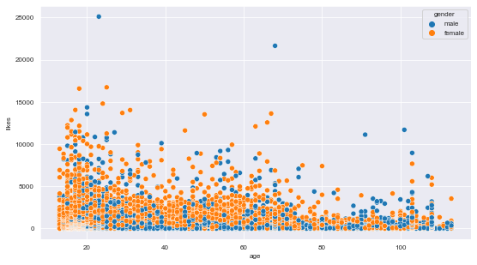
SCATTER PLOT TRACKING LIKES
This scatter plot is tracking the number of likes received across genders and as can be seen the highest number of likes have been received for male posts followed by female posts

Slide 18
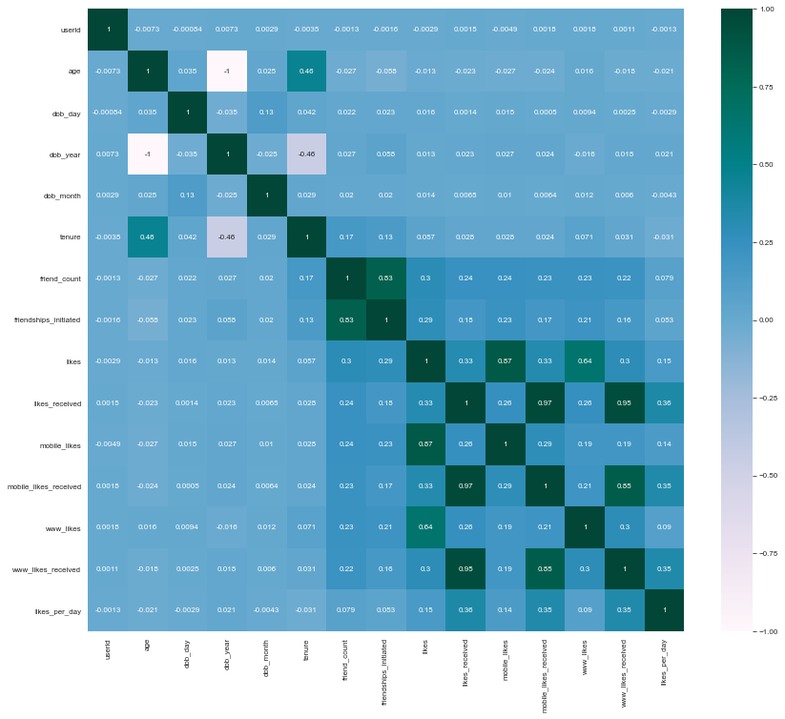
USING A HEAT MAP TO TRACK CORRELATION
We are using a heat map to track the correlation across the columns in the dataset.
As can be seen there is a high correlation between the variables in the dataset

Slide 19
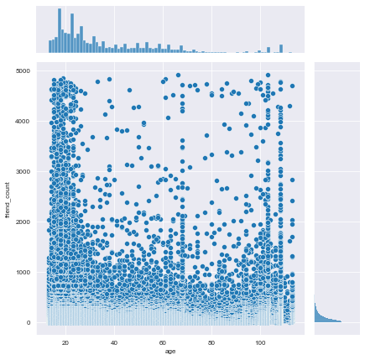
USING A JOINT PLOT TO FURTHER TRACK CORRELATION BETWEEN AGE AND FRIEND COUNT
The joint plot on this slide is tracking the correlation between the age and the number of friends for the particular age group. As can be seen, friendship count is high and concentrated in the 0-25 age group

Slide 20
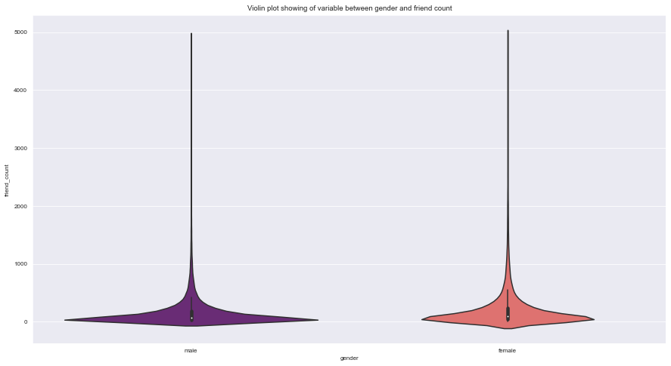
USING A VIOLIN plot to track the relationship between gender and friend count
There is a variance in the friend count as can be seen in the plot between the two gender groups

Slide 21
actionable insights
People in the age group of 21 to 30 are the most active on facebook
There is a positive correlation between the friend count and friendships initiated
Likes are more frequently done through the mobile app instead of the web-based application of Facebook
Females have more friends in comparison to males on Facebook dataset
There is a high correlation between the various variables in the dataset

Slide 22


